Slide 1
WTX
Analytics Challenge
Bruno Nunes Trevelin

Slide 2
Step 0: Define Problem
You work in a big credit card company and the company is having difficulties retaining customers. Cards cancellations are significantly growing! The company directors are now looking for some direction on where to start addressing the issue and find hypothesis for what's triggering these cancellations.
Which customers have a bigger tendency to cancel the card ? Is there any insight/hypothesis we can derive from data? What can we do to avoid more cancellations ?
The only data point we have available is the customer database the finance department extracted with customers who have cancelled and who are still in using the active.

Slide 3
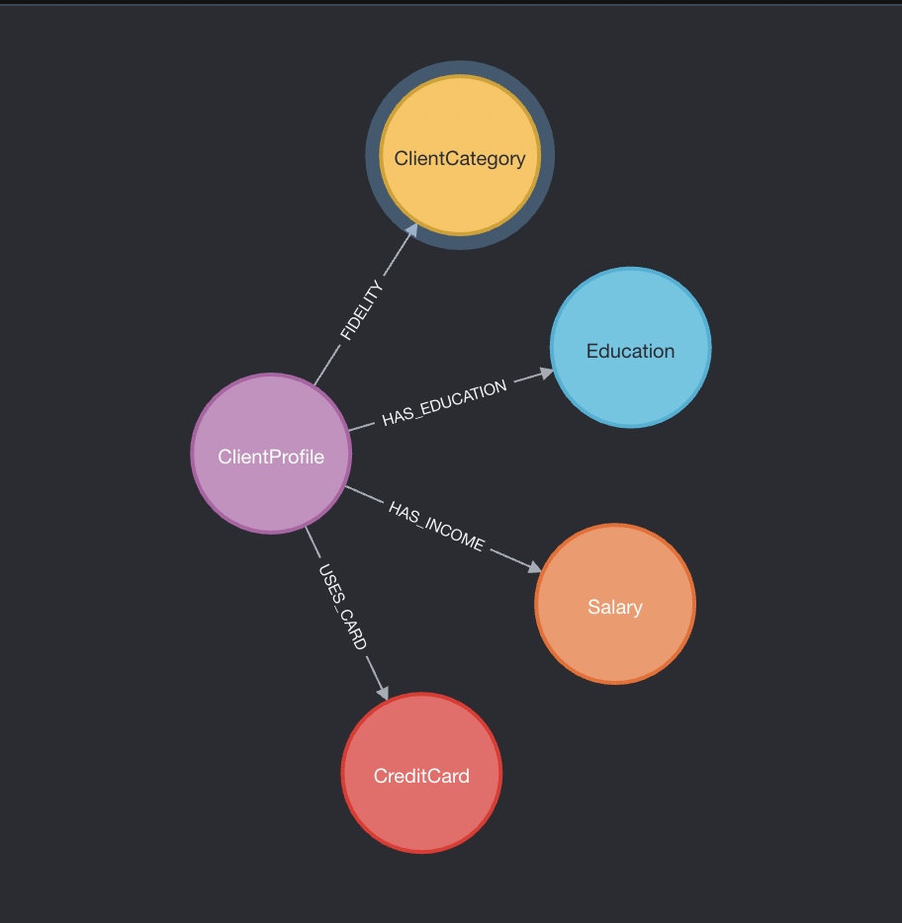
Step 1: Data Analysis
Read clients.csv data to understand keys and values
Set up a model/schema for our data, so we create a Graph database on neo4j to further get insights and conclusions analysing Nodes/Relations Credit Card related
Data model/schema defined ->

Slide 4
Step 2: Data Manipulation
Actions to take on data before starting creating the database:
On Excel .csv file:
Null and blank data values are converted to None, so we won't have data conflicts creating the database (Ex: Card type had 1 Null)
Blank spaces on Columns fields were removed to get and read data on python more clearly
On Python pipeline code:
For values: Commas " , " were changed to dots " . " and converted to number types

Slide 5
Step 3: Pipeline development
Using mainly Python and neo4j, created the pipeline steps as functions, so we just need to run then 1 by 1 at the order to create the database fully on neo4j
This part is on a github public repository, with the code instructions step by step
https://github.com/brunonunest/wtx-analytics-challenge

Slide 6
Step 4: Data visualization
4.1 Understanding our model
Nodes are circles and relations are arrows
Each Node/Relation has its properties
Next slides will present each Node/Relation properties ->

Slide 7
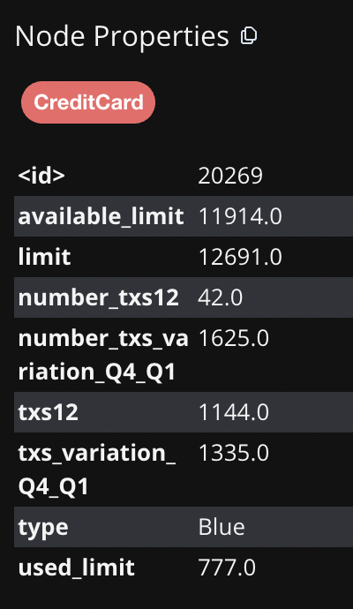
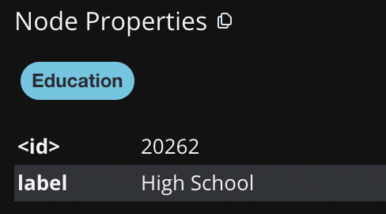
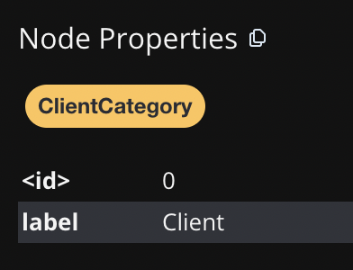
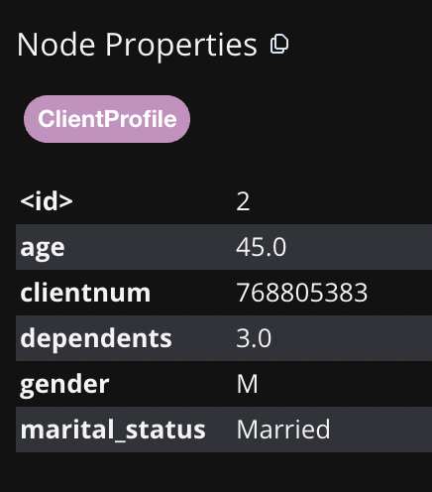
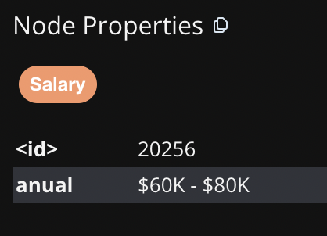
Nodes properties examples:

Slide 8
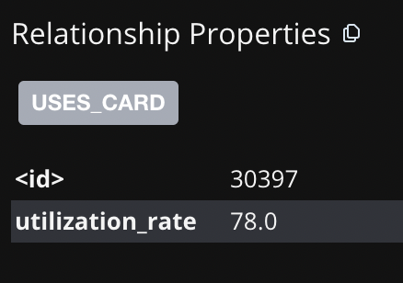
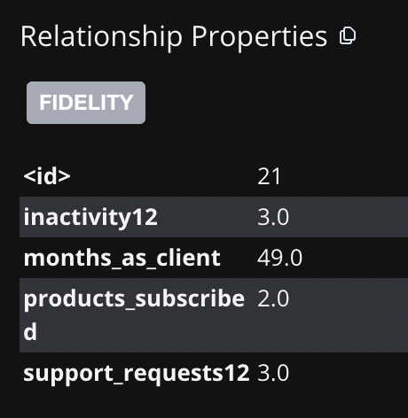
Relations properties examples:
** The other Relations have no properties, only an id, so they can connect Nodes

Slide 9
Step 5: Insights with focus in solving the problem
*Queries used will be represented by reference (example #01), so they can be consulted on github queries.py
1.
Get total ClientProfiles that cancelled, query #01 —------>
Get total ClientProfiles that are active, query #02 —------>
Conclusion: Active are currently around 5x Cancelled
1627
8500

Slide 10
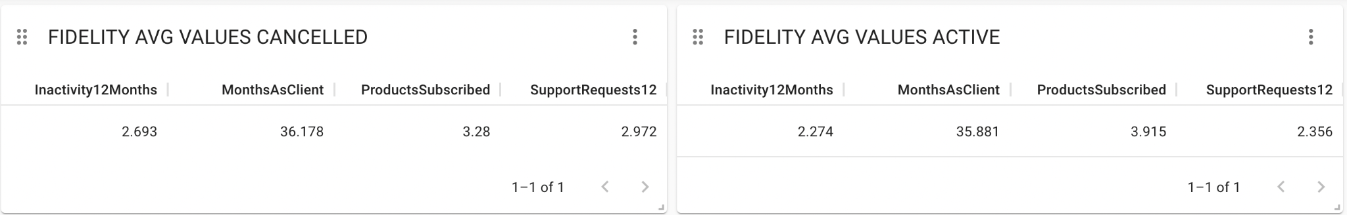
Insights
*Queries used will be represented by reference (example #01), so they can be consulted on github queries.py
*Neo4j native dashboard model
2.
Get average values for Fidelity Properties, compare Cancelled X Active, query #03
Conclusion:
No relevant difference between Fidelity data comparison, data is almost equal for both Cancelled and Active

Slide 11
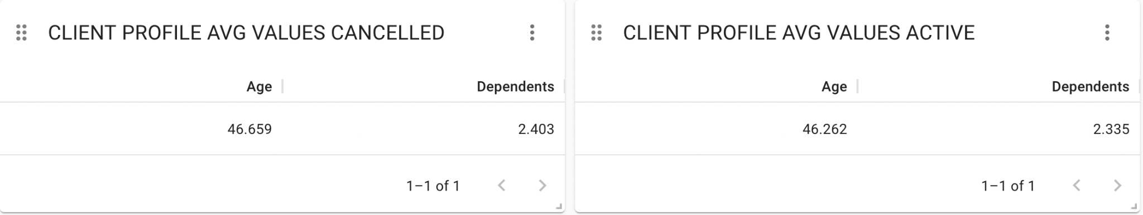
Insights
*Queries used will be represented by reference (example #01), so they can be consulted on github queries.py
3.
Get average values for Client Profile, compare Cancelled X Active, query #04
Conclusion:
No relevant difference between Client Profile data comparison, data is almost equal for both Cancelled and Active

Slide 12
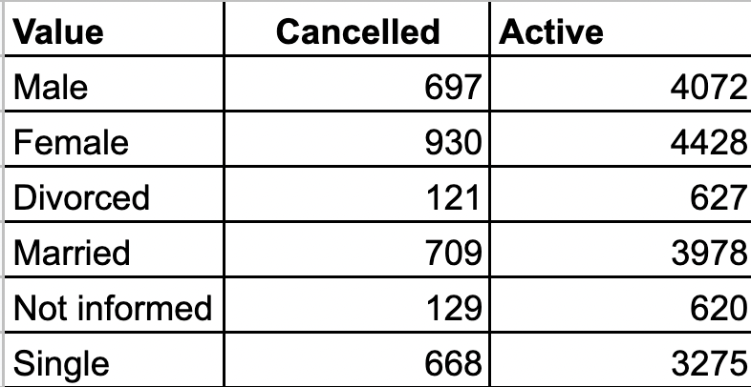
Insights
*Queries used will be represented by reference (example #01), so they can be consulted on github queries.py
4.
Get values count for Client Profile Marrital Status and Gender, compare Cancelled X Active, query #05
Conclusion:
1. Relevant difference between all of them, all active clients counts are higher than the cancelled ones, so that says that in general more people tend to be credit card active despites the gender or marrital status.
2. Considering totals for cancelled, we could say that considering those values, Males, Females, Married and Single are most likely to cancel than the others and could be the target for actions to avoid cancellations

Slide 13
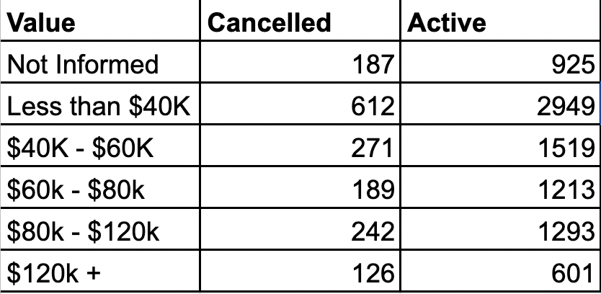
Insights
*Queries used will be represented by reference (example #01), so they can be consulted on github queries.py
5.
Get values count for Salarys, comparing Cancelled X Active for each range, query #06
Conclusion:
1. Relevant difference between them, active counts in general are higher, that says that more people tend to be credit card active despites the income.
2. Considering totals for cancelled, we could say that is prior to act on Less than 40k type that cancels, followed by $40k - $60k and $80k - $120k to avoid cancellations ($120k + could also be considered for the retaining clients actions, as it means more money $$$)

Slide 14
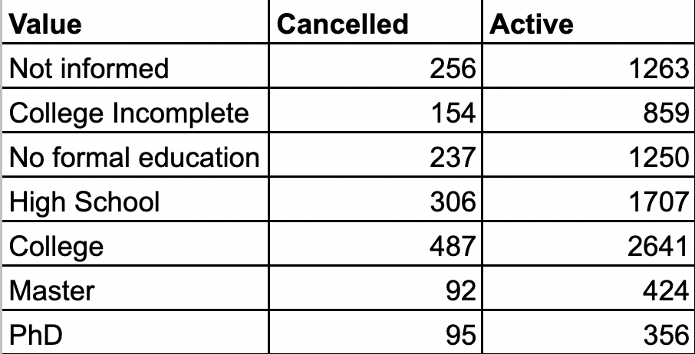
Insights
*Queries used will be represented by reference (example #01), so they can be consulted on github queries.py
6.
Get values count for Education levels, comparing Cancelled X Active, query #07
Conclusion:
Comparing the results we could say that the more educated the person is, the more likely it is to be an active credit card client
Considering the totals for cancelled, we could say that actions to avoid cancellation should be focus in College and High School, and after that the No formal education + Not informed

Slide 15
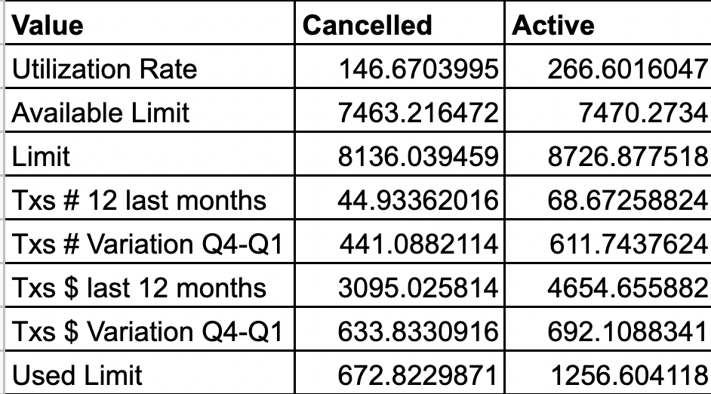
Insights
*Queries used will be represented by reference (example #01), so they can be consulted on github queries.py
Conclusion:
1. Cancelled Clients tends to have limits lower around -10% compared to actives, they make around 50% less transactions and the txs variation Q4-Q1 for them tends to increase 50% less than the actives.
2.Value spent for cancelled are 50% less than the actives and the variation Q4-Q1 for the value spent also tends to be less in 10%
3. Cancelled clients spend around 50% less than their limit compared to actives
7.
Get values count for Credit card info, comparing Cancelled X Active, query #08

Slide 16
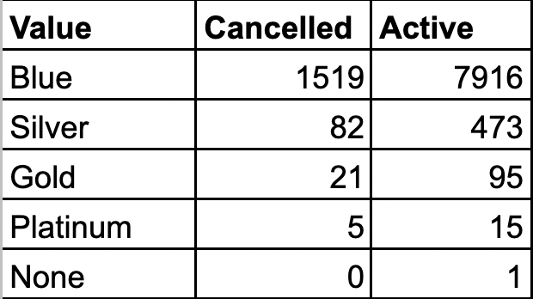
Insights
*Queries used will be represented by reference (example #01), so they can be consulted on github queries.py
Conclusion:
1.Blue type tends to have more clients in general (cancelled and active), so must be the first for the actions to retain clients and avoid cancellations
2.Silver takes 2 place on people active + cancelled, should be the second for acting to retain more people
3.Gold takes third place to be considered on actions to retain customers
4.Platinum has really few people and cancellations, should be the number 4 on our act rank
8.
Get values count for CreditCard types, comparing Cancelled X Active, query #09

Slide 17
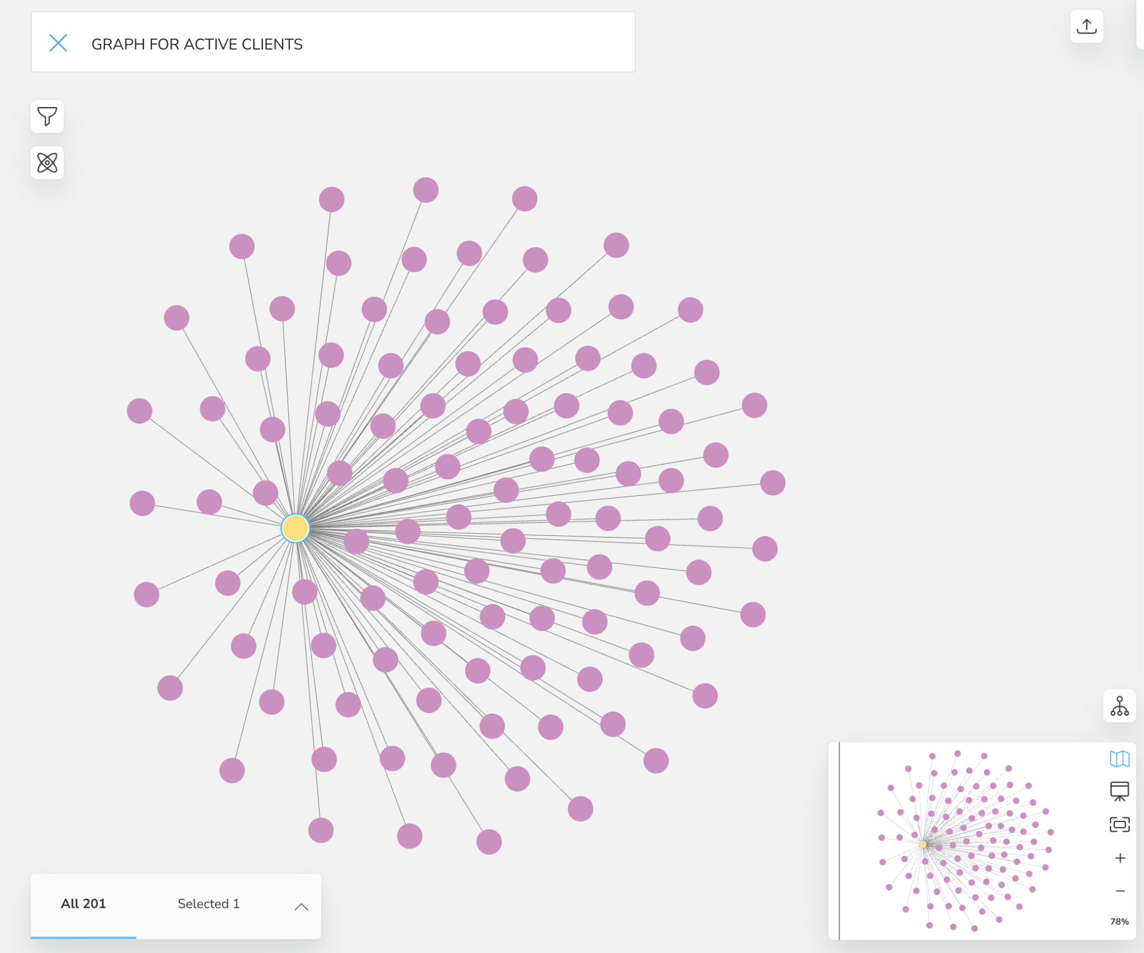
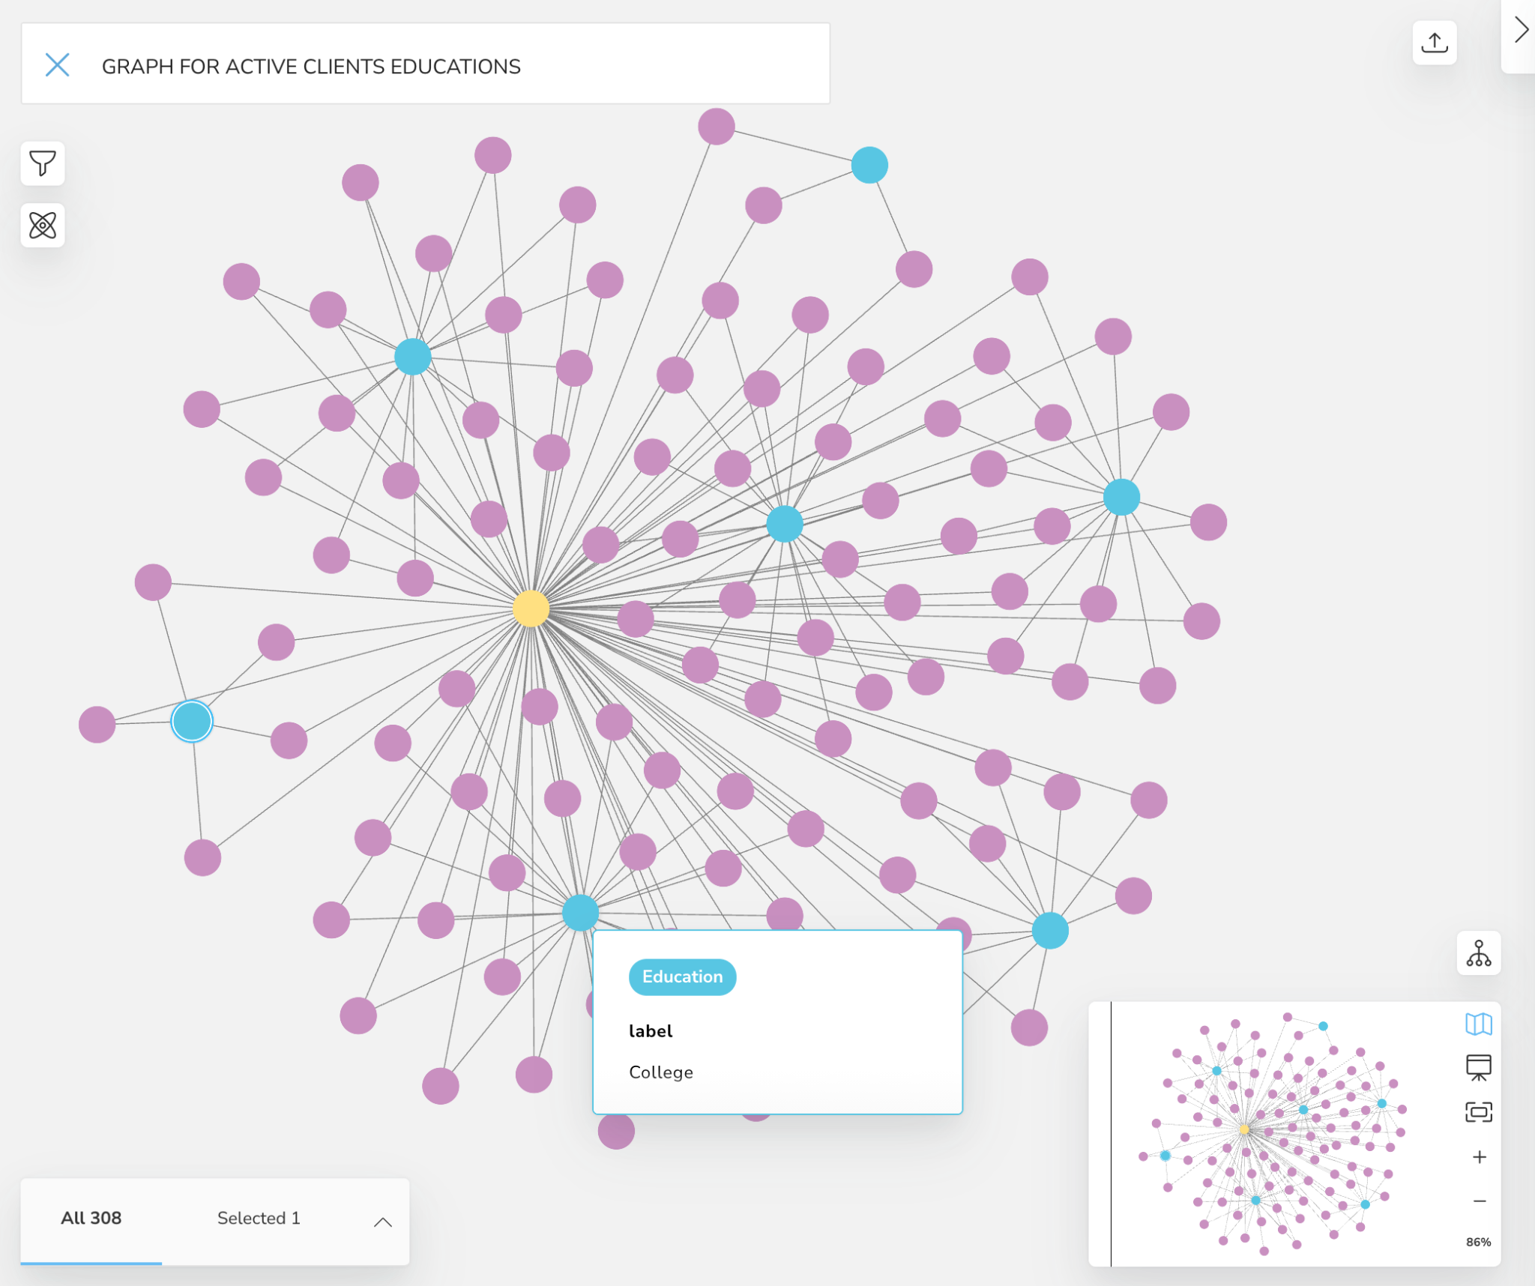
Views of the Insights - Limiting by 100 Nodes
Query #02 - LIMIT 100
Query #07 - LIMIT 100

Slide 18
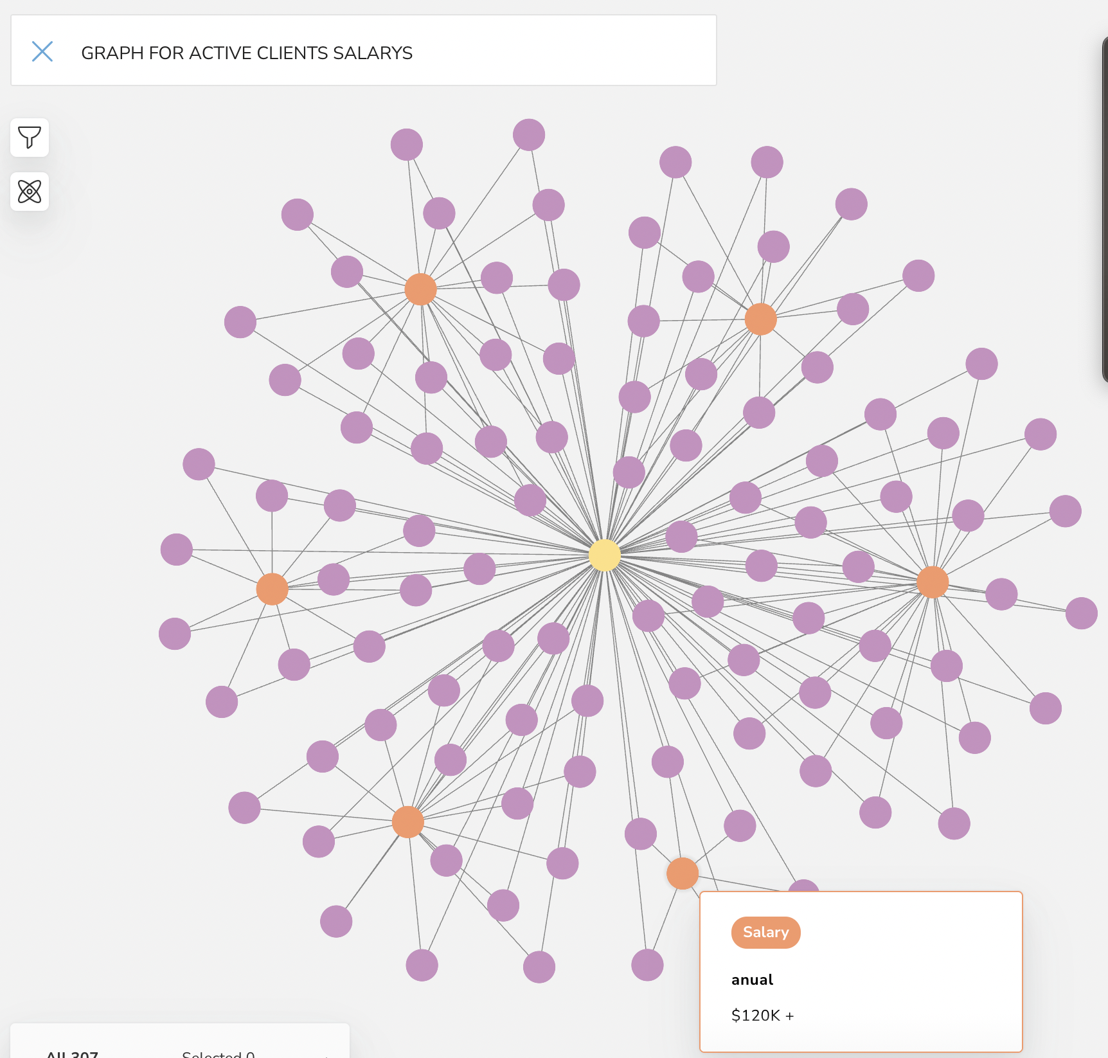
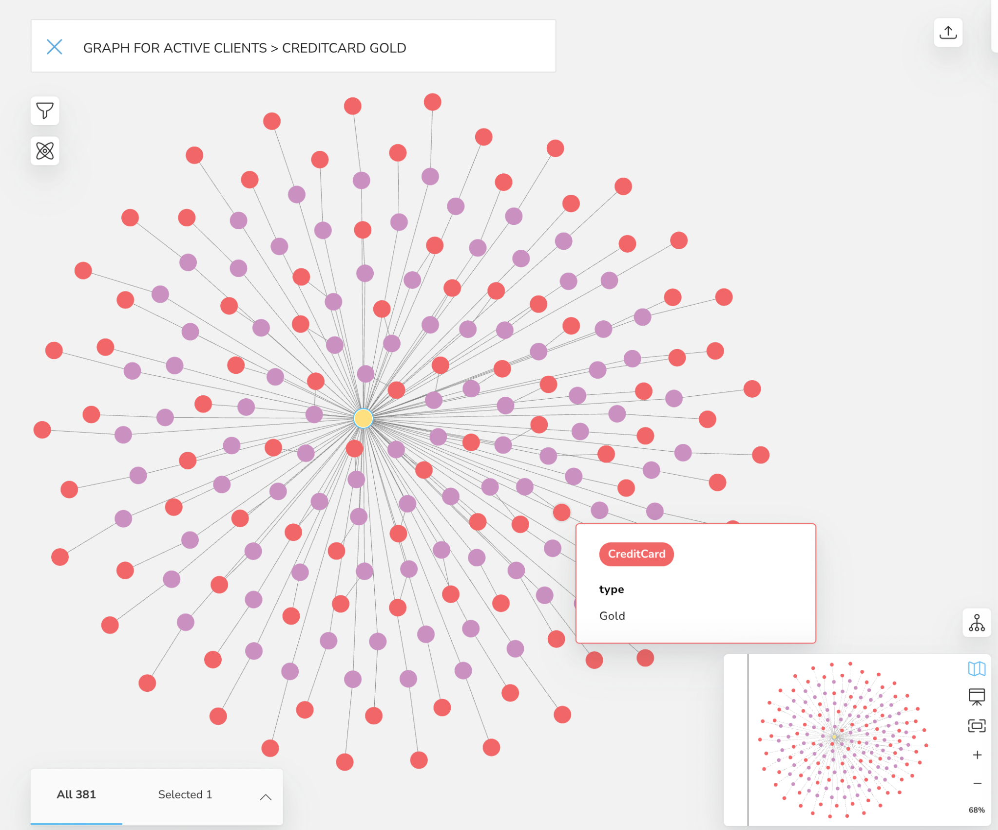
Views of the Insights - Limiting by 100 Nodes
Query #06 - LIMIT 100
Query #09 - LIMIT 100

Slide 19
Solution
Considering our Analysis, since the database creation until Insights about credit card data for cancellations, we can answer the problem questions:
1. Is there any insight/hypothesis we can derive from data? What can we do to avoid more cancellations ?
R= Yes, we could say that the data analysis shows us some main properties of clients that could be the profile target to act for avoiding more cancellations:
Blue type cards: are the ones that have more number of cancellations
Clients with Lower Limits, lower transactions and transactions variations in value and quantity, the ones that usually spend considered less limit as well are the ones most likely to cancel the card
The educated people are usually lower for the cancellations, and the main ones are College and High School
Salary, the main annual incomes that cancel are Less than 40k type, followed by $40k - $60k and $80k - $120k
Marrital Status and Gender usually have more cancellations for Males, Females, Married and Singles
Age and dependents values does not have relevant difference for cancellations and actives cards, as the fidelity properties as well
2.So what triggers the cancellation to the company to be aware of?
R=They happen more often in Blue Card Types, with clients that have lower limits, transactions and value spent compared to general,, mainly for College and High School clients, that has salary income between less than $40k and $60k (sometimes also around $80k - $120k), with marital status Married or Single
3.To conclude, considering all the questions, what is the direction the company should follow to act on cancellations and retain more clients?
R=Considered the profile we defined at the questions 1 and 2, the solution would be to focus on its properties values to create actions within the purpose to retain them as clients, this way the actions will be more accurate and directed to the right public that is more likely to cancel

